Slide 1
MINI PROJECT II “CHAT-ON”
Submitted to-
Dr. Ruchi Gupta
Sr. Technical trainer
Submitted by-
Aryan Jaiswal(191500158)
Divyam Goel(191500272)

Slide 2


WHAT IS REACT ??
React is a free and open-source front-end JavaScript library for building user interfaces based on UI components. It is maintained by Meta and a community of individual developers and companies. React can be used as a base in the development of single-page, mobile, or server-rendered applications.

Slide 3
PEREQUISITES FOR THIS PROJECT
You should be familiar with programming concepts like functions, objects, arrays, and to a lesser extent, classes.
You should have a basic knowledge of JavaScript
You should have some familiarity with HTML and CSS
Finally, if you have worked with React before, you already know a lot about Stream API, and there should be absolutely no problem in working with it
SETUP THE DEVELOPMENT ENVIRONMENT
Install Node JS on the system.
Install stream-chat-react and stream chat from website.
To communicate with the Stream Chat API, create an instance of Stream Chat client with your API key and pass via props into the Chat component.

Slide 4


Table of contents
Login Screen
We have created user authentication on the home screen with the help of API.
Home Screen
It contains information regarding the channels and the users on the platform.
Search Screen
User can search for channels or groups and friends on the provided search facility.
Thread Screen
One can comment , reply or give reaction on a particular message on thread.
Edit Channel Screen
On this page , user has the ability to edit a channel name and its member.
Conclusion
A chatting website is created to contact and be in touch with your friends and family

Slide 5
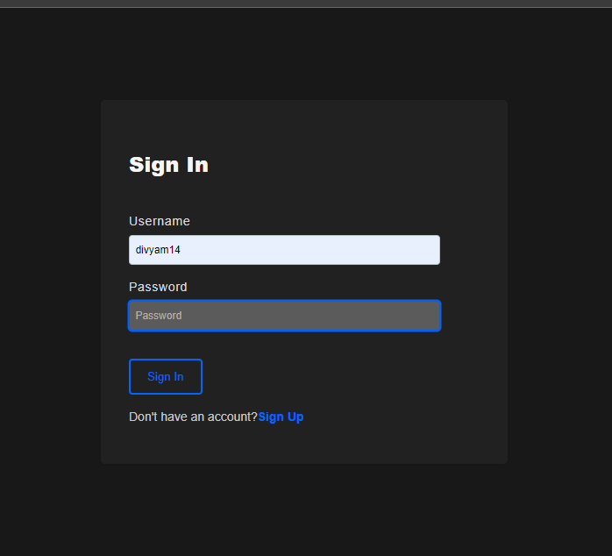
Login Screen
The Login Screen of this app provides user authentication using Stream API in the backend.
The user can Register or Login using the respective buttons.

Slide 6
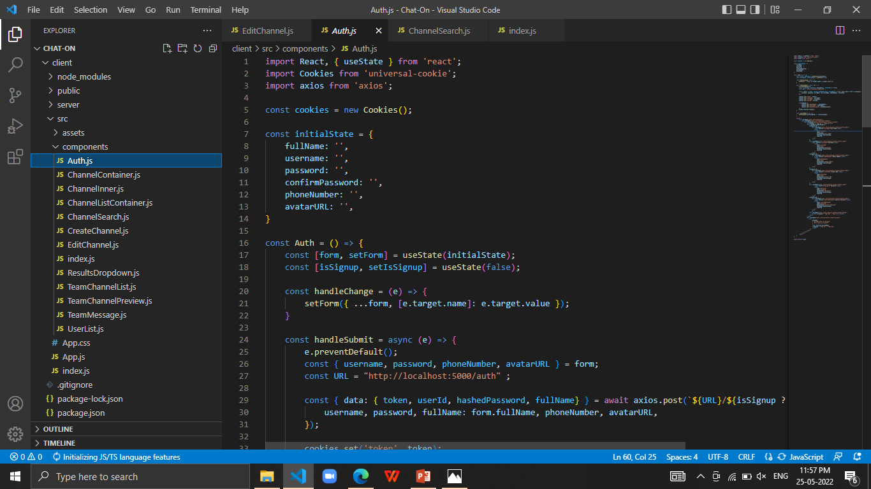
Code snippet of login screen

Slide 7
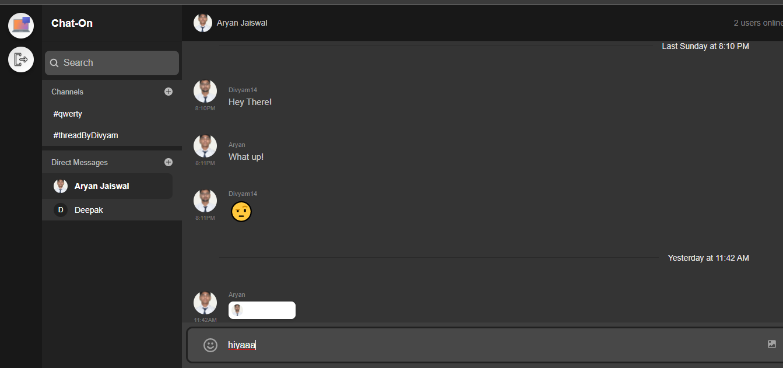
Home Screen
The home screen displays various channels created by the user. It also includes the search box and also shows the direct messages. The user can start a chat and even log out from the home screen.

Slide 8
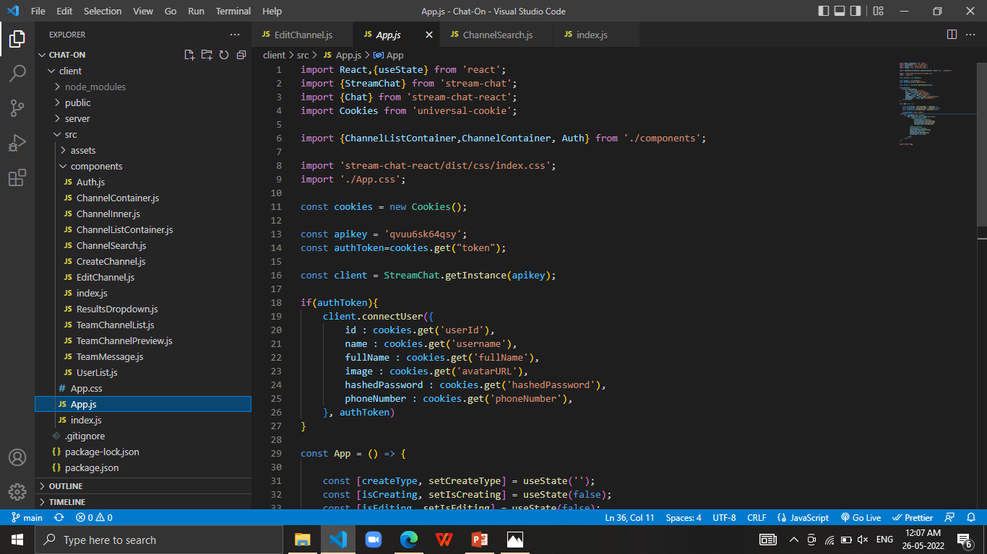
Code snippet of home screen

Slide 9
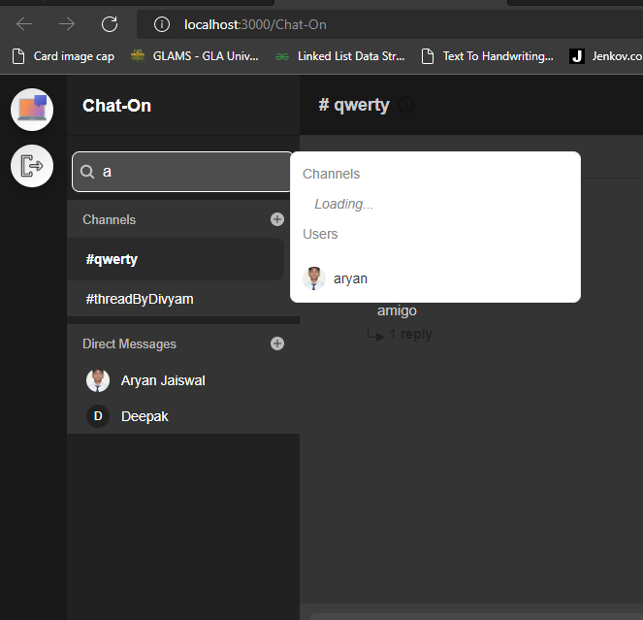
Search Screen
The search screen provides the search space where a user can find a particular user and channel along with its information.
The seacrh button can be accessed on the home screen at the left side.

Slide 10
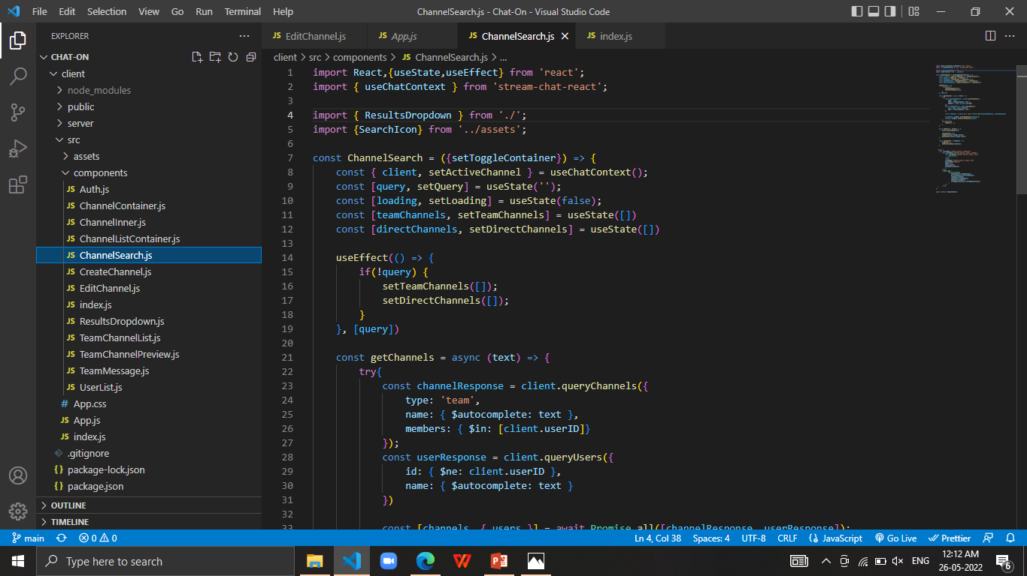
Code snippet of search screen

Slide 11
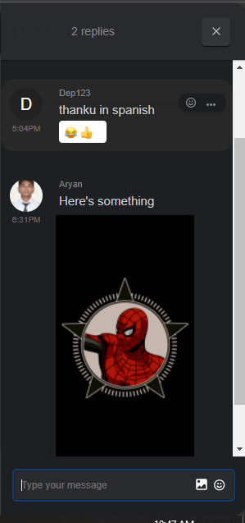
Thread Screen
The user’s specific reply or comment appears in this screen.

Slide 12
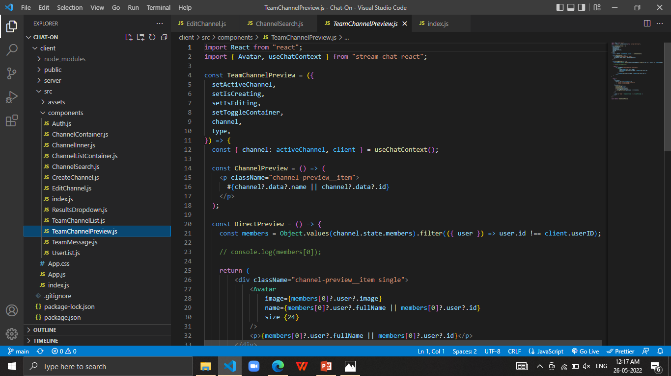
Code Snippet of thread screen

Slide 13
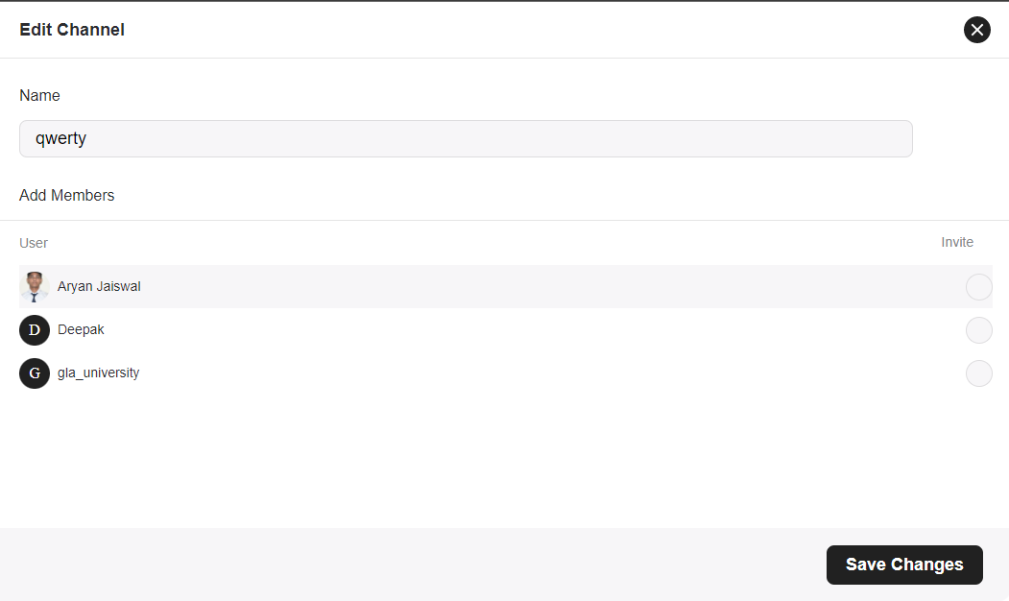
Edit Channel Screen
One can change name of the channel on this page. Removing or adding a member to the channel functionality is also provided.

Slide 14
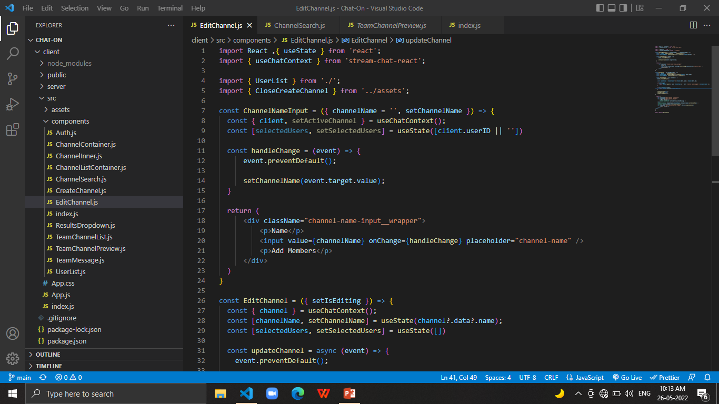
Code Snippet of Edit Channel Screen

Slide 15
CONCLUSION
Proposed Chat-On Website is based on React that will allow users to chat personally as well as in groups. This application takes in a user authentication and enables the user to contact with friends and family. Joyful conversation is possible with emoji’s and stickers.

Slide 16
Project related Documents
Synopsis:
https://github.com/aryanjais/Chat-On/blob/main/Chat-OnSynopsis.pdf
Project Report
https://github.com/aryanjais/Chat-On/blob/main/Chat-On%20Final%20Report.pdf
Repository Link
https://github.com/aryanjais/Chat-On

